Slide 1



Alphabet Recognition System Using Python
This presentation will delve into the design and implementation of an Alphabet Recognition System, showcasing how Python, machine learning, and computer vision collaborate to recognize handwritten alphabets in real-time. We'll explore the system's architecture, training process, and practical applications.
by Kovid Khanna
KOVID KHANNA 500105251
ARYAN CHAUDHARY 500105282

Slide 2
Technological Foundation
Machine Learning Frameworks
Computer Vision Tools
The system relies on Keras, a powerful library for building and training neural networks, and NumPy for numerical computations and data preprocessing.
OpenCV, a widely used library, handles real-time video capture, preprocessing, and contour detection. These tools provide the foundation for processing and analyzing images captured from a webcam.

Slide 3



Dataset Preparation
EMNIST
1
Data Loading
2
The EMNIST dataset is loaded using the python-mnist library, providing a rich source of handwritten letters for training.
Preprocessing
3
Pixel values are normalized to a range between 0 and 1 for faster convergence, and labels are one-hot encoded to represent the output classes for the neural network.

Slide 4
Model Architecture
Input Layer
1
The input layer flattens the 28 × 28 grayscale image into a single vector, enabling the neural network to process the image data.
Hidden Layers
2
Two dense layers with 512 neurons and ReLU activation, along with dropout layers, contribute to the model's learning capacity and prevent overfitting.
Output Layer
3
A dense layer with 26 neurons, representing each alphabet, utilizes a softmax activation for probability distribution, providing confident predictions.

Slide 5
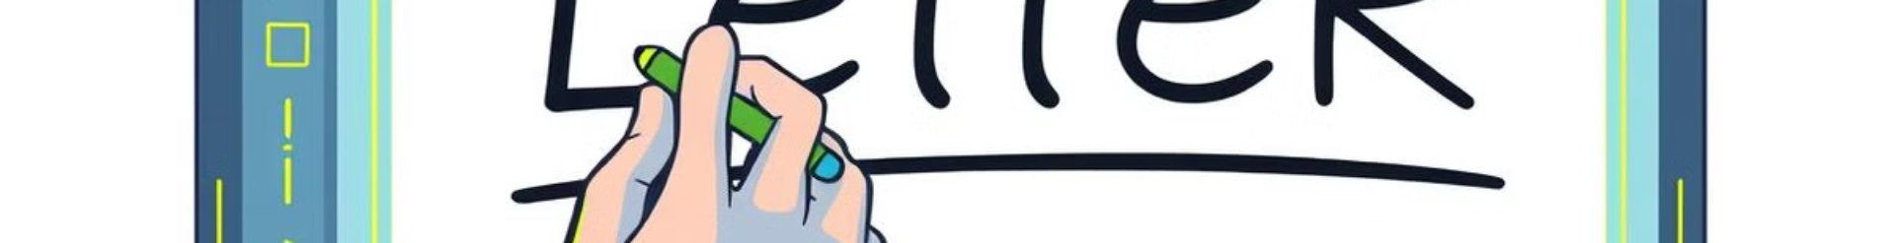




Real-Time Recognition
Video Capture
OpenCV captures video frames from the webcam, flipping them to create a mirror view for the user.
Preprocessing
The frame is converted to HSV color space, and the region containing the blue marker is detected using color thresholds. Morphological operations are applied for better detection accuracy.
Drawing and Recognition
A bounding box is drawn around the detected contours, and the region is resized to 28 × 28, processed into the model format, and fed to the trained neural network for prediction.
Visualization
The webcam feed is displayed with the live prediction of the drawn character. The predicted letters are clearly displayed on the screen.

Slide 6
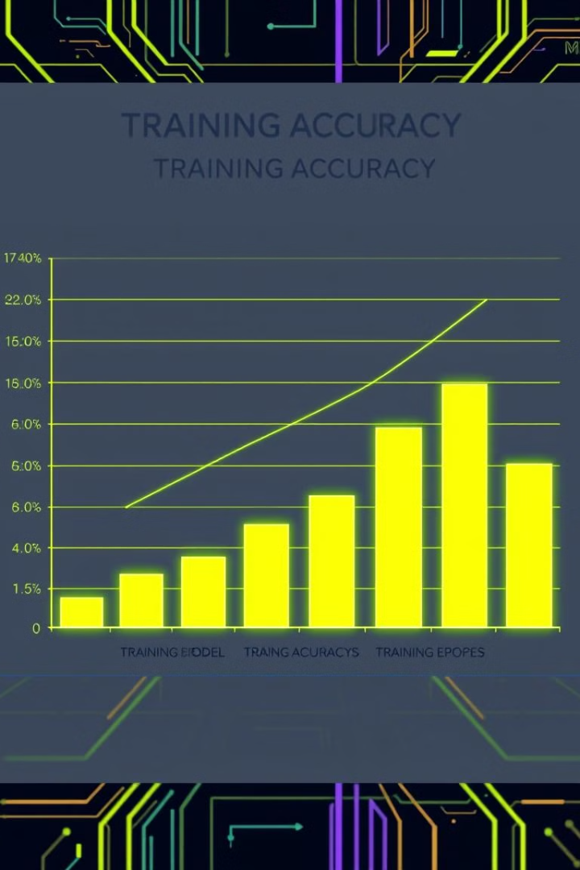
Performance Evaluation
98%
95%
Training Accuracy
Test Accuracy

Slide 7

Challenges and Future Directions
Challenges
Future Scope
Noise in the real-time feed can lead to inaccurate predictions. Handling poorly written or ambiguous characters is a significant challenge. The system is currently limited to uppercase letters.
The system can be extended to recognize lowercase letters, digits, and special characters. Integrating gesture-based controls will enhance usability. Optimizing the model architecture for faster real-time predictions is a priority. Preprocessing techniques can be improved to handle noise more effectively.

Slide 8

Conclusion and Takeaways
Real-Time Applications
This project demonstrates the practical application of deep learning and computer vision in real-time scenarios. By combining the EMNIST dataset, a feedforward neural network, and OpenCV for input processing, this project successfully recognizes handwritten letters, bridging the gap between human input and computational interpretation.

